Slide 1

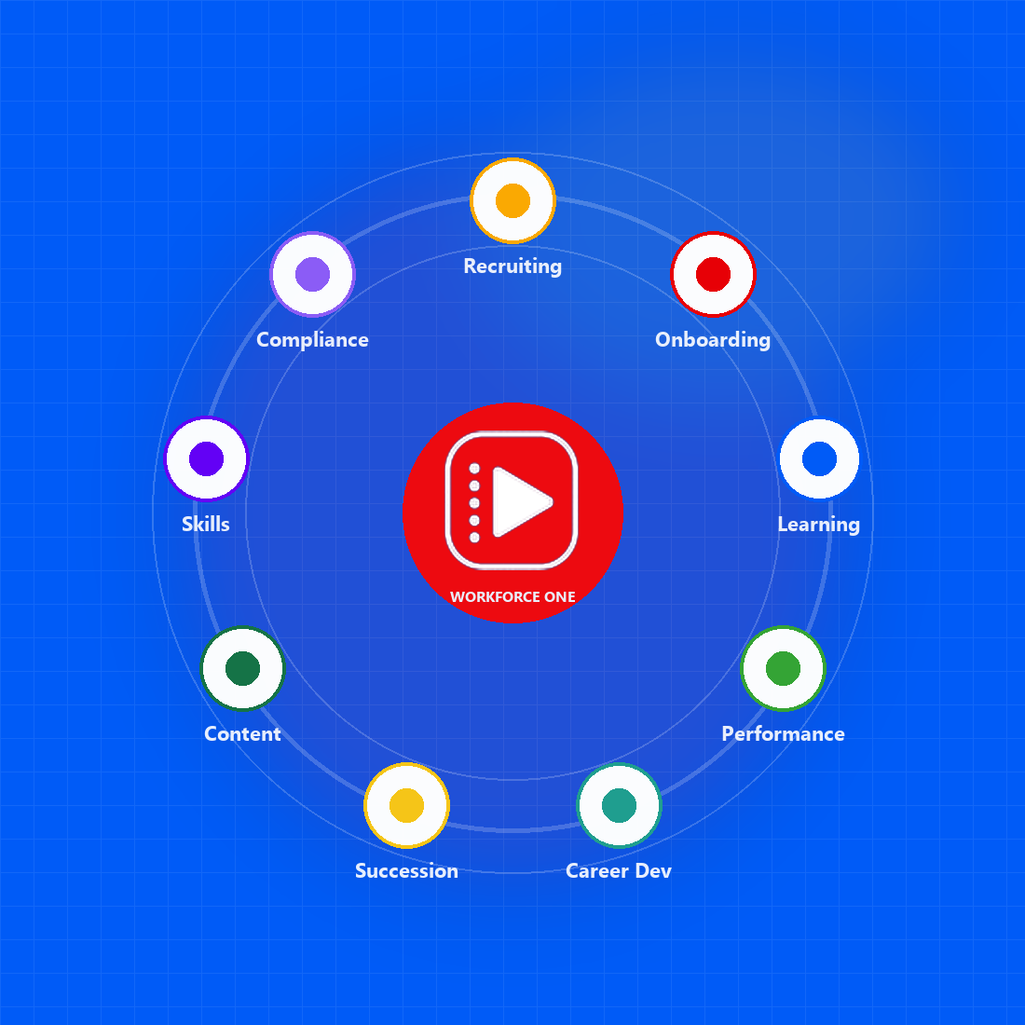
WORKFORCE PLATFORM FOR GROWING TEAMS
Intelligent Workforce One
Recruit. Learn. Perform. Grow.
Replace a stack of hiring, learning, and performance tools with one platform — built for SMB and mid-market teams, with healthcare as the lead vertical.
Ziora · Workforce One
01 / 13
Notes:
Open with the buyer: growing teams funding too many SaaS apps.
Workforce platform first; learning is the foundation. Healthcare is proof, not the only vertical.

Slide 2
WHAT IS ZIORA
One platform. Learning at the core.
Ziora Workforce One gives every employee a single record across recruiting, onboarding, learning, and performance — so people, skills, and compliance stay connected.
One connected record
Learning is the foundation
Hire, ramp, train, and review the same person. No duplicate profiles, no handoffs that drop history.
Courses, pathways, live training, and certifications sit at the center of how people become productive and stay ready.
Built by practitioners
Ready for regulated work
20+ years of enterprise learning and workforce transformation, applied to a platform teams can actually run.
Healthcare is the lead vertical, with the same model for manufacturing, airlines, banking, retail, and distribution.
Ziora · Workforce One
02 / 13
Notes:
Ziora Solutions is the company; Workforce One is the product.
Do not claim customer logos, SOC 2, HIPAA, or public pricing.

Slide 3
VALUE PROPOSITION
What we are solving
Your workforce already runs. SMBs still have to budget and maintain a stack of SaaS tools that do not talk to each other.
THE PROBLEM
THE VALUE
01
Disconnected systems
01
One employee record
Recruiting, onboarding, learning, and performance each hold their own version of a person.
Every stage shares the same person, skills, and history.
02
Too many SaaS tools
02
One platform to fund and run
SMB customers struggle to budget and maintain multiple applications for hiring, training, and performance.
Replace a stack of subscriptions with one workforce platform that is simpler to budget and maintain.
03
No workforce visibility
03
Hire to productivity
Skills, completion, and readiness live in separate tools, spreadsheets, and inboxes.
New hires move into assigned learning and manager visibility without re-entry.
04
Compliance and audit risk
04
Records you can stand behind
Training records do not travel with the employee, so audit packs are assembled by hand.
Completions, certificates, e-sign, and audit trails in one place.
Ziora · Workforce One
03 / 13
Notes:
This is the cost-of-doing-nothing slide.
Lead with SMB budget pain: multiple SaaS apps are expensive to buy and hard to keep running.
Close the loop: one record and one platform, not another point tool.

Slide 4
MARKET DIFFERENTIATION
Why organizations choose Ziora
Not another LMS bolted onto an ATS. A modern workforce platform built to replace disconnected tools.
01 Workforce One, not point tools
02 LMS and learning experience together
03 AI inside the workflow
Recruiting, onboarding, learning, and performance share one employee record instead of four logins.
Manage courses, assign paths, and deliver the learner experience from the same product.
Recommendations, summarization, and recruiting match sit in the work — licensed where they are tenant modules.
04 Expert implementation
05 Production-ready in two weeks
06 Historical LMS migration
Consultants with 20+ years in enterprise learning, not a ticket queue after go-live.
Rapid deployment with proven onboarding — not a nine-month integration program.
Bring users, learning history, and certifications from legacy platforms with minimal disruption.
Ziora · Workforce One
04 / 13
Notes:
Enterprise control is the proof, not the pitch: SSO, RBAC, e-sign, Teams, GDPR admin, multi-language.
Do not name competitors.

Slide 5
THE PLATFORM STORY
One person. One record.
The candidate you hire is the employee you onboard, train, review, and promote — without starting over in another system.
01 Candidate
02 Offer accepted
03 Employee created
Sourced, screened, and interviewed in one pipeline.
Offer letter and e-sign stay on the same record.
No re-entry. The hire becomes the employee.
04 Day-one learning
05 Perform and grow
06 Next role
Role-based paths, compliance, and checklists assigned automatically.
Goals and reviews sit with the training that created the skill.
Job progression measured on skills readiness, not course count.
Ziora · Workforce One
05 / 13
Notes:
Walk the lifecycle left to right before you open feature slides.
The point is one record, not six products.

Slide 6
KEY FEATURES
Learning
Prove compliance and skills readiness without a second learning system.
Courses and content
Assignment and recurring training
Learner experience
SCORM 1.2 and 2004, video, documents, exams, and versioned uploads.
Programs and pathways with assignment tracking, plus recurring required training that stays current.
End-user interactions, carousels, and learning spaces.
Skills ontology and career pathing
Dashboards and recommendations
Live training and compliance
Skills ontology and tagging. Career pathing and job progression measured on skills readiness.
Custom dashboards, a manager dashboard, learning recommendations, and assignment tracking.
Instructor-led classes, observation checklists, completion, certification, e-sign, and audit trails.
Ziora · Workforce One
06 / 13
Notes:
Show skills tagging into career pathing, then manager dashboard and recurring training.
Job progression is measured on skills readiness, not course count alone.

Slide 7
KEY FEATURES
Performance
Development stays on the same record as the training that created the skill — not a once-a-year review file.
Goals that cascade
Review cycles
Team performance
Company, team, and personal goals with approvals and a shared catalog.
Cycles, templates, self and manager reviews, and printable packets.
Managers see their people, progress, and reviews without a spreadsheet export.
Continuous feedback
Development connected to learning
One talent hub
Feedback stays on the employee record, not in a side channel.
Growth needs can become courses and pathways, not a note that goes nowhere.
Goals and performance sit with the same employee the recruiting and learning teams already know.
Ziora · Workforce One
07 / 13
Notes:
Do not claim a social recognition feed or calendar 1-on-1 product.
The differentiator is the connection to learning, not a standalone OKR tool.

Slide 8
KEY FEATURES
Recruiting
The person you hire is the person you train. Hiring does not stop at the offer.
Requisitions and approvals
Candidate pipeline
Careers and apply
Open roles with structured intake, approvals, and recruiter dashboards.
Screen, interview, and move people through a shared hiring workflow.
Public careers pages, applications, and a self-service applicant view.
Offers
Internal mobility and referrals
Resume intelligence
Offer-letter templates that travel with the requisition, not a side Word file.
Marketplace and referral flows so the next hire can already be inside.
Resume extraction to speed screening — then the hire becomes the employee record.
Ziora · Workforce One
08 / 13
Notes:
Stress the handoff: hired candidate → employee → learning assigned.
Resume extractor and AI match are capabilities, not a promise to replace recruiters.

Slide 9
KEY FEATURES
Onboarding
Day one is assigned, tracked, and visible to the manager — from the hire you already made.
Hire to employee
Role-based learning from day one
Observation checklists
Accepted offer creates the employee from the candidate you already hired.
Programs, pathways, and required courses assigned to the new role.
Manager and buddy sign-off on the job — not a PDF in email.
E-sign and acknowledgements
Compliance in the first week
Manager visibility
Required policies and records with an audit trail, not a shared drive.
Mandatory training lands with the same completion records the rest of the workforce uses.
Team dashboards show who is assigned, in progress, and complete.
Ziora · Workforce One
09 / 13
Notes:
Do not list equipment inventory, payroll, benefits, or leave as product features.
Onboarding is the learning-led ramp after recruiting, not a standalone HRIS.

Slide 10
WHAT YOU TURN OFF
One platform instead of a stack.
Growing teams should not fund a separate ATS, LMS, onboarding process, and review tool. Name the systems you stop paying for.
TURN OFF
KEEP RUNNING IN ZIORA
01
Standalone ATS
01
Hiring through to employee
Hiring that stops at the offer, then someone re-keys the person into HR and learning.
Requisitions, pipeline, offers, and the hire that becomes the employee record.
02
Separate LMS
02
Learning and compliance
A second login for courses, compliance, and certificates that never reach the employee record.
Courses, paths, live training, certifications, e-sign, and audit trails.
03
Spreadsheet onboarding
03
Day-one ramp
Checklists, policy PDFs, and day-one training tracked in email and shared drives.
Role-based assignments, observation checklists, and manager visibility from the hire.
04
Once-a-year review tool
04
Performance on the same record
Goals and reviews in a file that does not know what the person actually learned.
Goals, reviews, and development connected to the skills the training created.
Ziora · Workforce One
10 / 13
Notes:
Do not name competitor products.
Ask which of these they are paying for today, then show the right column.

Slide 11
HOW WE WORK TOGETHER
From first conversation to live in two weeks.
A buying path, not a nine-month integration program. You bring roles and content; we bring the platform and the implementation.
01 Health check
02 Demo with your content
03 Migrate history
04 Go live
Ten questions. A Workforce Management Score. A clear picture of the gap before anyone sits in a demo.
Walk recruiting, learning, and performance with your roles — not a canned tour of empty screens.
Bring users, learning history, and certifications from the legacy LMS with minimal disruption.
Production-ready in two weeks, with consultants who have run enterprise learning — not a ticket queue.
Ziora · Workforce One
11 / 13
Notes:
Health check is the no-commitment first step.
Two weeks is the deployment claim already on the differentiation slide — keep it consistent.

Slide 12
CUSTOMER FEEDBACK DELIVERED
We hear you!
This was feedback from the customer that we implemented.
✓
Video playback controls (e.g., disabling fast-forward or cursor movement) are typically managed within the configuration of the respective course content.
Done
✓
Importing and tracking training completed outside the LMS.
Done
✓
SOP audio generation in local languages (e.g., Telugu, Hindi, etc.).
Done
✓
Roster enhancement: Ability to upload attendance sheets with signatures/images to centralize documentation for audit readiness.
Done
✓
Bulk import of training attendance from Excel into the roster.
Done
✓
Enable reminders and push notifications from the roster module.
Done
Ziora · Workforce One
12 / 13
Notes:
Every item on this slide is shipped — walk with checkmarks, not a roadmap.
Use this when the customer asked for specific LMS enhancements.

Slide 13

NEXT STEP
See it with your workforce.
Start with a 10-question health check, or sit down for a demo with your roles and content. One ask: pick a date.
Built by practitioners with 20+ years in enterprise learning and workforce transformation.
Request a demo
Take the health check
Sales@ziora.co
ziora.co/request-demo
ziora.co/workforce-healthcheck
Request a Demo
Health Check
LinkedIn
Ziora · Workforce One
13 / 13
Notes:
Primary ask is the demo. Health check is the easier yes if they are not ready to schedule.
Do not send them to Instagram from a sales close.

