Slide 1
Learning Management System
Learning administration · Delivery · Assignments · Compliance
Notes:
Ziora's Learning Management System is part of Workforce One. This overview covers how learning is administered, delivered, assigned and tracked for compliance.

Slide 2
Agenda
About Ziora
03
How Ziora is different
04
LMS core objects
05
Learner groups and audiences
06
Learning content and delivery
07
Training assignments and progress
08
Learner registration and completions
09
Auditing, compliance and exceptions
10
Your requirements
11
System overview and analytics
12
Notes:
Nine topics: who Ziora is, what makes the LMS different, how it is structured, how content reaches learners, and how training is assigned, completed and audited. We finish with your requirements.

Slide 3
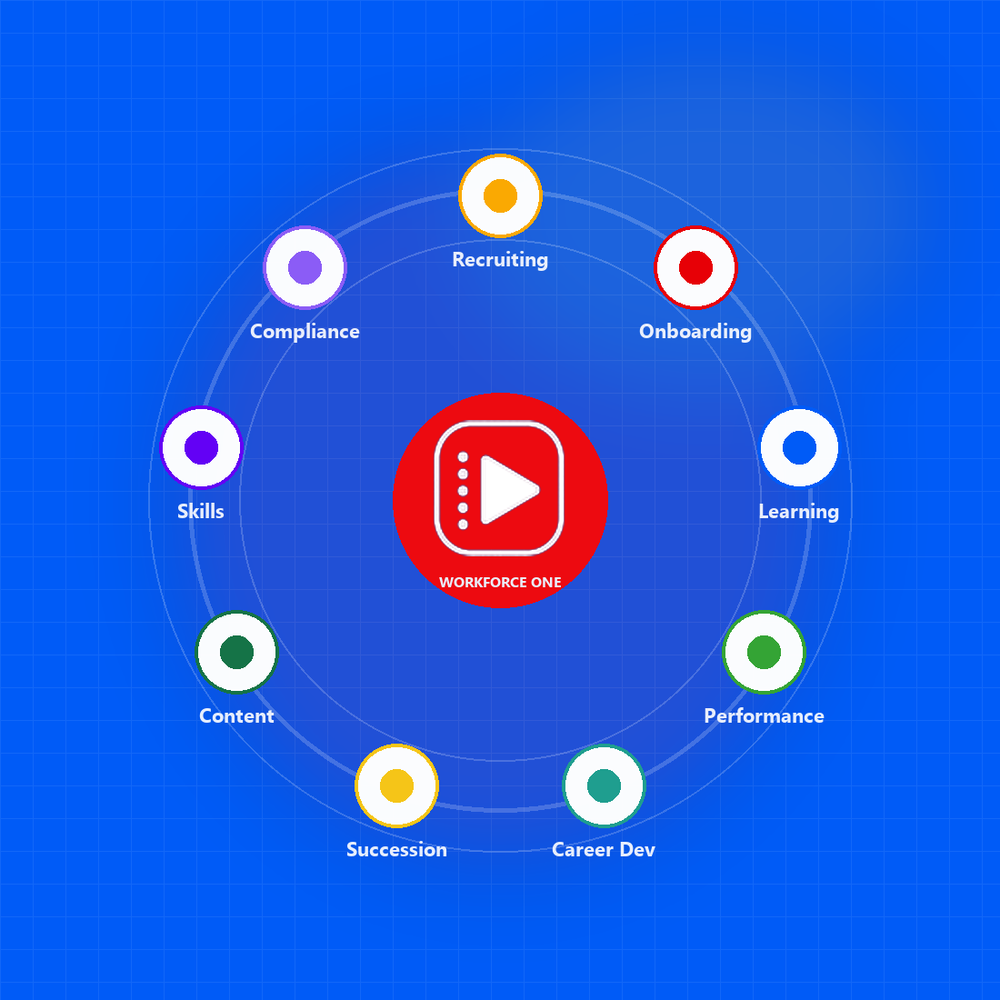

ABOUT ZIORA
Ziora - Workforce One platform
Ziora Workforce One connects every stage of the workforce journey on one AI-powered platform, with learning at its core. The person you hire is the person you train, review and prepare for the next role.
Established in 2024
Workforce One platform
Built to make corporate learning engaging, effective and accessible.
Recruiting, onboarding, learning, performance, skills and succession on one employee record.
Learning at the core
Built for regulated industries
Courses, programs, live training and certifications sit at the center of how people grow.
SOC 2 and HIPAA certified, with compliance training, renewals and audit trails.
Notes:
Ziora was established in 2024. Workforce One puts recruiting, onboarding, learning, performance, skills and succession on one employee record, with learning at the core.

Slide 4
How Ziora is different
MARKET DIFFERENTIATION
Not another standalone LMS. A learning system built into the platform your whole workforce already uses.
01
One integrated platform
02
100+ years of combined experience
03
Live in four weeks
Learning shares one employee record with recruiting, onboarding and performance — no separate LMS login or re-keying.
A leadership team with more than 100 combined years in LMS and talent management.
A faster implementation cycle, with users, history and certifications moved from your current LMS.
ZIORA VS A TYPICAL LMS
TYPICAL LMS
ZIORA
The platform
×
Disconnected systems, each holding its own version of a person
✓
One platform, with learning at the core of every role
How you go live
×
A nine-month integration; new hires re-keyed into learning
✓
Production-ready in four weeks; users, history and certifications migrated
Support for people
×
Separate logins; managers export spreadsheets to see progress
✓
One record from candidate to next role; day-one paths and compliance
Adherence to readiness
×
Training records in a separate system; audit packs built by hand
✓
Completions, certificates and e-sign on the employee record
Client experience
×
The same demo for everyone; a ticket queue after go-live
✓
A walkthrough mapped to your workflows; requests built and shipped fast
Notes:
Three differences: one integrated platform, a leadership team with more than 100 combined years in LMS and talent management, and implementation in about four weeks. The table compares Ziora with a typical LMS across the platform, going live, support for people, adherence to readiness and the client experience.

Slide 5



LMS core objects
FOUNDATION
Everything in the LMS is built from three families of objects: the people and structure you train, the learning you deliver, and how you evaluate it.
PEOPLE & STRUCTURE
LEARNING
EVALUATION & ON-THE-JOB
Users
Jobs and positions
Organizations and divisions
Skills
Groups (rule-based audiences)
Online courses: SCORM, video and documents
Instructor-led classes
Virtual sessions
Training programs and pathways
Assessments
Training plans and assignments
Observation checklists
Diplomas and certifications
Notes:
Everything in the LMS is built from people and structure, the learning you deliver, and how you evaluate it.

Slide 6
Learner groups and audience segmentation
AUDIENCES
Groups find the right learners with flexible rules, so visibility and assignments follow people automatically.
EXAMPLE RULES
Rules decide who is in a group
Filter on job, organization, manager, language, start date, custom fields or all users.
User's job is Plant Operator
User's organization is Choutuppal Clinic
Membership keeps itself current
As people change jobs or organizations, their groups — and their training — follow.
User's start date is after 1 Oct 2026
Groups drive visibility and access
Rules combine with AND — people must match every rule. Several values inside one rule combine with OR.
Make a course visible to a group so its members can find and register for it.
RESULT
New operators in Choutuppal plant see onboarding courses and get them assigned on day one.
Groups drive assignments
Assign required or recommended training to a group with one due date or rolling due days.
Notes:
Groups find learners with rules. Different rules combine with AND; several values in one rule combine with OR. Membership updates as people change jobs or organizations, and groups drive both visibility and assignments.

Slide 7



Learning content and delivery
CONTENT
Self-paced and live training in one catalog, with AI that turns documents into audio and summaries.
ONLINE COURSES
INSTRUCTOR-LED
ADDITIONAL AREAS
SCORM packages, videos and documents
Configurable supported file types
Internal or external launch URLs
Multi-language content, including Telugu and Hindi
AI-generated audio and summaries
Schedule many classes for one course
Virtual ILT with Microsoft Teams
Rosters, attendance and completions
Instructor schedules and locations
Training programs
Assessments
Observation checklists
Self-reported training
Diplomas
Certifications
Skills
Notes:
Online courses, instructor-led and virtual classes, and additional learning such as programs, assessments, checklists, self-reported training, diplomas, certifications and skills.

Slide 8
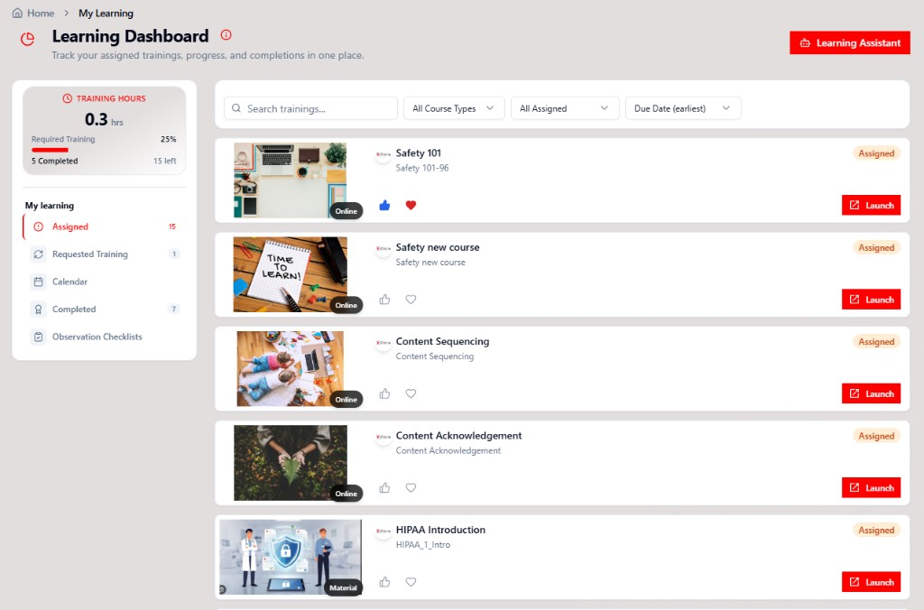
Training assignments and progress
ASSIGNMENTS
Assign once and track everywhere — administrators, managers and learners each get a view built for them.
Assign by user, job, organization or group
Target one person or everyone who matches — new members are picked up automatically.
Required or recommended
Mark mandatory training as required, with a due date or rolling due days.
Administrator: Assigned Training Summary
Assigned, satisfied, in progress and overdue for every training in one view.
Manager: Team Dashboard
Managers see and manage their team's training without a spreadsheet export.
Learner: Learning Dashboard
Each learner sees what's assigned, what's due and what's complete.
Notes:
Assign by user, job, organization or group, as required or recommended. Administrators use the Assigned Training Summary, managers the Team Dashboard, and learners the Learning Dashboard.

Slide 9
From visible to complete
LEARNER EXPERIENCE
Learners reach training through the Learning Dashboard. What they can see and launch depends on their groups and assignments.
01
02
03
04
05
In the course's group
Assigned or self‑registered
Launch
Complete
Recorded
Group membership makes the course visible in the catalog.
Learners can register for any visible course — an assignment isn't always needed.
Open the training from the Learning Dashboard.
Pass the score, attend the class, or sign off — with e‑signature where required.
Completion, history and diploma stay on the employee record.
Good to know: learners must belong to the course's group to launch and complete it — even when the course is assigned to them directly.
Notes:
Learners see courses through their groups and either get assigned or register themselves, then launch from the Learning Dashboard. Learners must belong to the course's group to launch and complete it, even when assigned directly.

Slide 10
Auditing, compliance and exceptions
COMPLIANCE
Prove who was trained, when and how — and handle the exceptions — without assembling audit packs by hand.
Assignment tracking
Electronic signatures
Observation checklists
Versioning
Messages and emails
Who is assigned, due, overdue and complete.
On rosters, completions and cancellations.
Signed-off, on-the-job skills checks.
Content versions with history kept intact.
Automatic notices for assignments and due dates.
Training exceptions
Audit trail reports
Data auditing and reports
Ad hoc report authoring
GDPR
Waive, extend due dates or reassign — with a reason.
Change history for assignments, people and catalog.
Standard learning, assessment and certification reports.
Drag-and-drop custom reports and charts.
Permanently remove data for people who have left.
Notes:
Tracking, e-signatures, checklists, versioning, notifications, exceptions such as waivers and extensions, audit trails, standard and ad hoc reporting, and GDPR purging.

Slide 11
Your requirements
QUICK CHECK
Let's tailor the discussion to your organization.
CURRENT ENVIRONMENT
KEY PRIORITIES
CAPTURE REQUIREMENTS
Are you using an LMS today? Which one?
Is this a replacement, an improvement or a first-time implementation?
Which capabilities matter most?
Any workflows, reports, integrations or approvals to consider?
What challenges should the LMS address?
Priority 1
Priority 2
Priority 3
Follow-up / owner
Notes:
Use this slide to capture the current LMS, whether this is a replacement or a first implementation, the capabilities that matter most, and the top three priorities with an owner.

Slide 12
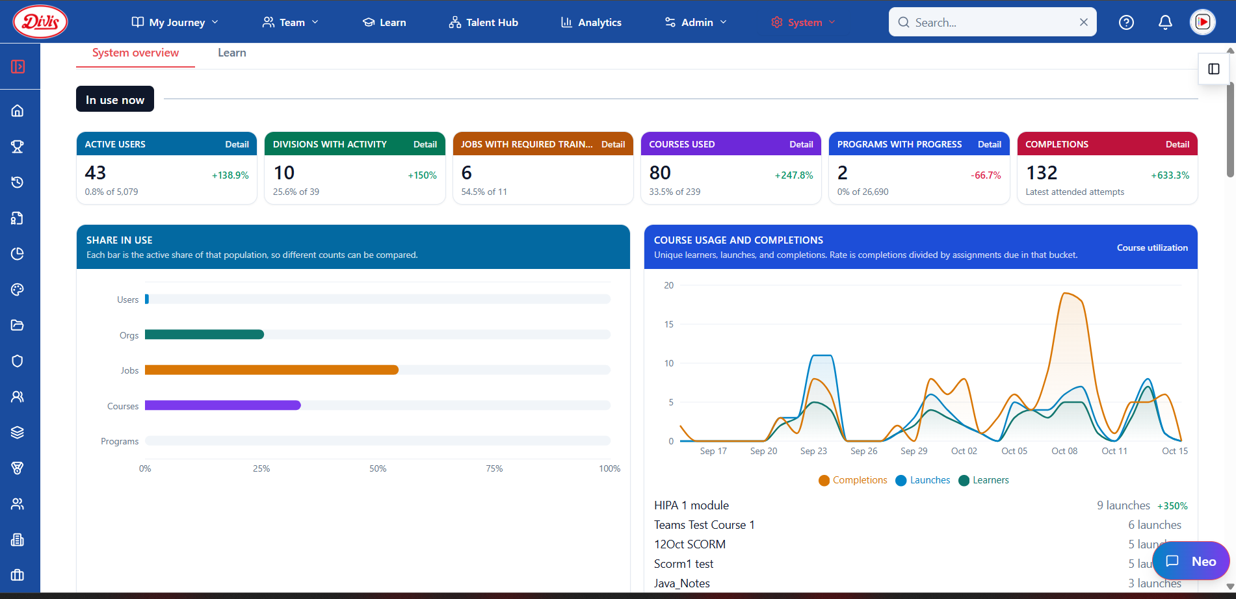
System overview at a glance
ANALYTICS
See how the LMS is being used right now — who is active, what is being launched and completed, and how that compares with the previous period.
In use now
Active users, divisions, jobs, courses, programs and completions, with change against the previous period.
Share in use
The active share of each population on one scale.
Course usage and completions
Daily learners, launches and completions, with the completion rate.
Most-launched courses
Top courses and their trend, with drill-down to the detail.
Notes:
The System overview shows how the LMS is used right now: active users, divisions, jobs with required training, courses, programs and completions with their change against the previous period, the active share of each population, and daily learners, launches and completions.

Slide 13
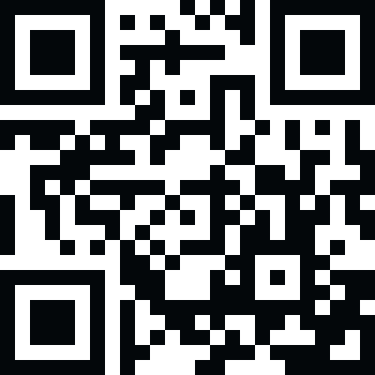
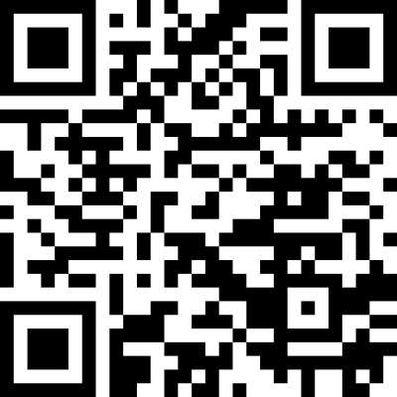
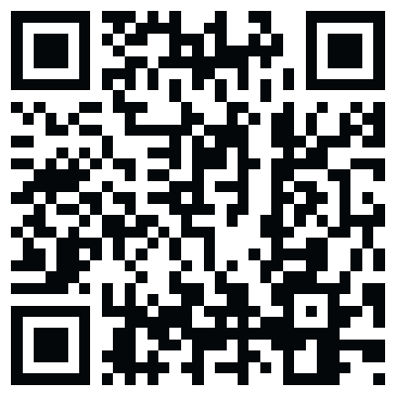
See Ziora Learning with your team.
BUILT FOR THESE INDUSTRIES
Healthcare
Manufacturing
Airlines
Banking
Retail
Distribution
Education
Technology
Consulting/Professional Services
Bring your courses, roles and compliance needs — we'll walk through them in the LMS.
Built by practitioners with 20+ years in enterprise learning.
Request a demo · Take the health check · Sales@ziora.co · ziora.co
Request a Demo
Health Check
LinkedIn
Notes:
Offer a demo mapped to their courses, roles and compliance needs, or the 10-question health check.

