Slide 1


YOUR PARTNER IN
WORKFORCE GROWTH
Helping organizations learn, grow, and succeed together
COMPANY PROFILE
01

Slide 2
INDEX
About Us
03
Mission & Vision
04
Our Core Principles and Values
05
Journey of Milestones
06
Meet the Founder
07
Our Platform
08
Enterprise Learning
09
Performance
10
Hire to next role
11
Why organizations choose Ziora
12
Us vs Them
13
02

Slide 3

ABOUT US
Ziora Solutions builds Workforce One, an AI-powered platform that connects recruiting, onboarding, learning, performance, skills, succession, and compliance on one employee record. Founded in 2024, Ziora began with a simple mission: make corporate learning more engaging, effective, and accessible. The work is led by practitioners with more than 20 years in enterprise learning and workforce transformation.
Founded in 2024
20+ Years of Practice
Started to make corporate learning engaging and accessible, and grew into one workforce platform.
Enterprise learning, talent, and workforce lifecycle experience, including Fortune 500 implementations.
Learning at the Core
One Employee Record
Courses, pathways, live training, and certifications sit at the center of how people become productive.
The person you hire is the person you onboard, train, review, and prepare for the next role.
Ready for Regulated Work
Hyderabad & the US
Healthcare leads, with the same model for manufacturing, airlines, banking, retail, distribution, and education.
A small, senior team working from Hyderabad, India and the United States.
03

Slide 4

MISSION
VISION
To bring the entire workforce into one unified platform where people, skills, employee engagement and growth stay connected, make corporate learning more engaging, effective, and accessible.
To be the trusted workforce platform for organizations that recruit, develop, and grow their people from one employee record.
04

Slide 5
OUR CORE PRINCIPLES AND VALUES
These values guide everything we do, from product development to customer success.
Innovation
Empower
Intelligent workforce solutions that shape how organizations learn.
Contextual, end-to-end solutions that help employees realize their true potential and growth.
Customer Obsession
Excellence
Built by a team of professionals who are customer obsessed with 20+ years each in Enterprise Learning and SaaS platforms.
In every product, partnership, and customer interaction.
05

Slide 6

OUR JOURNEY OF MILESTONES
2024
20+
8
2 wks
7
1
FOUNDED
YEARS OF
PRACTICE
CONNECTED
MODULES
TO GO LIVE
INDUSTRIES
EMPLOYEE
RECORD
06

Slide 7

MEET THE FOUNDER
The founder, and a small senior team building Workforce One.
FOUNDER & MANAGING DIRECTOR
SRINIVAS NADAKUDITI
Visionary leader with over 20 years in learning, talent management, and the workforce lifecycle. Srinivas has led enterprise-scale implementations across Fortune 500 companies, connecting learning strategy to measurable performance.
Ziora is a small, senior team in Hyderabad and the United States, building Workforce One so organizations can hire, train, and grow from one employee record.
Recruiting
Onboarding
Learning
Performance
Skills
Succession
Content Authoring
Compliance
07

Slide 8
OUR PLATFORM
ALL-IN-ONE WORKFORCE PLATFORM
Ziora Workforce One brings every stage of the workforce journey into one AI-powered platform — from recruiting and onboarding to learning, performance, skills, succession, and content creation. Learning sits at the core: the person you hire is the person you train, review, and prepare for the next role on one employee record. Built for growing teams, with healthcare as the lead vertical.
RECRUITING & ONBOARDING
LEARNING
PERFORMANCE & GROWTH
PLATFORM & COMPLIANCE
Requisitions and approvals
Candidate pipeline
Careers pages and apply
Offers and e-sign
Hire becomes the employee
Day-one learning paths
Observation checklists
Manager visibility
Courses, SCORM, video, exams
Pathways and assignments
Recurring required training
Live instructor-led classes
Certifications and audit trails
Learner experience
Skills ontology
AI content authoring
Goals that cascade
Review cycles
Continuous feedback
Development tied to learning
Career pathing
Skills readiness
Succession planning
One talent record
One employee record
E-sign and acknowledgements
Dashboards for managers
SSO and role permissions
Legacy LMS migration
AI in the workflow
Healthcare lead vertical
Live in two weeks
08

Slide 9
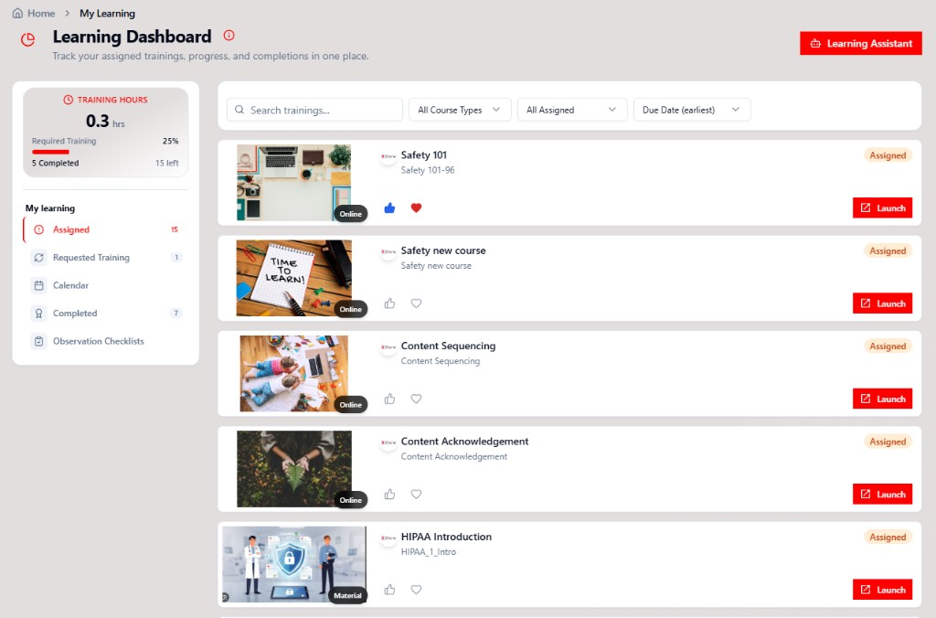
WORKFORCE ONE
ENTERPRISE LEARNING
Prove compliance and skills readiness without a second learning system — authoring, programs, checklists, and reporting in one place.
Content Authoring
Create AI-powered courses, assessments, and materials in minutes.
Compliance
Keep mandatory training current with assignments, renewals, and audit trails.
Certifications
Track certifications, renewals, and completion records in one place.
Training Programs
Programs and pathways with assignment tracking and recurring required training.
Observation Checklists
Manager and buddy sign-off on the job — with records that travel with the employee.
Gamification
Engaging learner experiences with recommendations and progress visibility people complete.
Analytics
Self-service report authoring with custom dashboards and dynamic reporting.
09

Slide 10
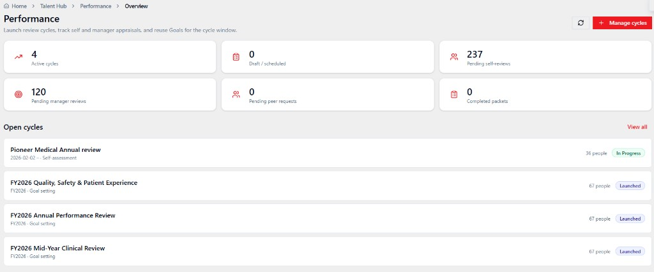
WORKFORCE ONE
PERFORMANCE & GROWTH
Development stays on the same record as the training that created the skill — not a once-a-year review file.
Goals that cascade
Company, team, and personal goals with approvals and a shared catalog.
Review cycles
Cycles, templates, self and manager reviews, and printable packets.
Team performance
Managers see their people, progress, and reviews without a spreadsheet export.
Continuous feedback
Feedback stays on the employee record, not in a side channel.
Development connected to learning
Growth needs can become courses and pathways, not a note that goes nowhere.
One talent hub
Goals and performance sit with the same employee recruiting and learning already know.
10

Slide 11
THE ZIORA ONE STORY
ONE PERSON. ONE RECORD.
The candidate you hire is the employee you onboard, train, review, and promote — without starting over in another system.
01
02
03
04
05
06
Candidate
Offer accepted
Employee created
Day-one learning
Perform and grow
Next role
Sourced, screened, and interviewed in one pipeline.
Offer letter and e-sign stay on the same record.
No re-entry. The hire becomes the employee.
Role-based paths, compliance, and checklists assigned automatically.
Goals and reviews sit with the training that created the skill.
Job progression measured on skills readiness, not course count.
11

Slide 12
MARKET DIFFERENTIATION
WHY ORGANIZATIONS CHOOSE ZIORA
Not another LMS bolted onto an ATS. A modern workforce platform built to replace disconnected tools.
01
02
03
Workforce One, not point tools
LMS and learning experience together
AI inside the workflow
Recruiting, onboarding, learning, and performance share one employee record instead of four logins.
Manage courses, assign paths, and deliver the learner experience from the same product.
Recommendations, summarization, and recruiting match sit in the work — licensed where they are tenant modules.
04
05
06
Expert implementation
Production-ready in two weeks
Historical LMS migration
Consultants with 20+ years in enterprise learning, not a ticket queue after go-live.
Rapid deployment with proven onboarding — not a nine-month integration program.
Bring users, learning history, and certifications from legacy platforms with minimal disruption.
12

Slide 13
US VS. THEM: HOW ARE WE DIFFERENT?
Disconnected systems and siloed learning versus one unified, engaging, enterprise-wide learning platform.
THE PLATFORM
REGULAR WAY
OUR WAY
☐ Disconnected systems that each hold their own version of a person
☐ Siloed learning that never reaches hiring or performance
☐ Another point tool added to an already fragmented stack
☑ One unified, engaging platform for the entire workforce
☑ Enterprise-wide learning at the core of every role
☑ Hiring, learning, and performance on one employee record
HOW YOU GO LIVE
SUPPORT FOR PEOPLE
REGULAR WAY
OUR WAY
REGULAR WAY
OUR WAY
☐ A nine-month integration program
☐ Re-key the new hire into learning and HR tools
☑ Production-ready in two weeks
☑ The accepted offer becomes the employee record
☑ Users, history, and certifications move from the legacy LMS
☐ Separate logins for hiring, training, and reviews
☐ Managers export spreadsheets to see progress
☐ People go unseen between review cycles
☑ One record from candidate to the next role
☑ Day-one paths, checklists, and compliance on the role
☑ Growth measured on skills readiness, not course count
ADHERENCE TO READINESS
CLIENT EXPERIENCE
REGULAR WAY
OUR WAY
REGULAR WAY
OUR WAY
☐ Training records trapped in a separate system
☐ Audit packs assembled from spreadsheets and inboxes
☑ Completions, certificates, and e-sign on the employee record
☑ Recurring required training that stays current
☑ A manager view of assigned, in progress, and complete
☐ The same demo for every organization
☐ A ticket queue after go-live
☑ A walkthrough mapped to your workflows
☑ Consultants with 20+ years in enterprise learning
☑ Customer requests that get built and shipped
13

Slide 14

See Workforce One with your team.
BUILT FOR THESE INDUSTRIES
Start with a 10-question health check, or sit down for a demo with your roles and content.
Healthcare
Built by practitioners with 20+ years in enterprise learning.
Manufacturing
Sales@ziora.co · ziora.co/request-demo · ziora.co/workforce-healthcheck
Airlines
Banking
Retail
Distribution
Request a Demo
Health Check
LinkedIn
Education
14

